Slide 1
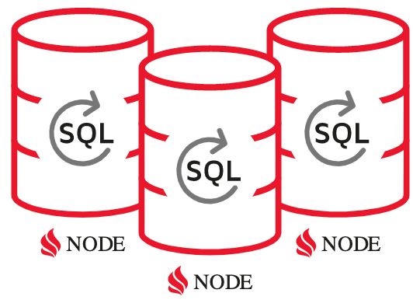




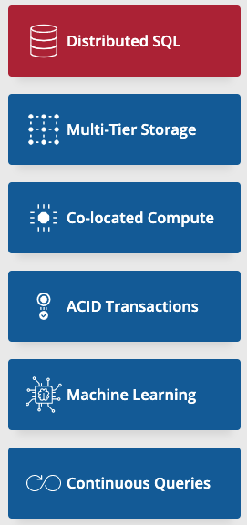
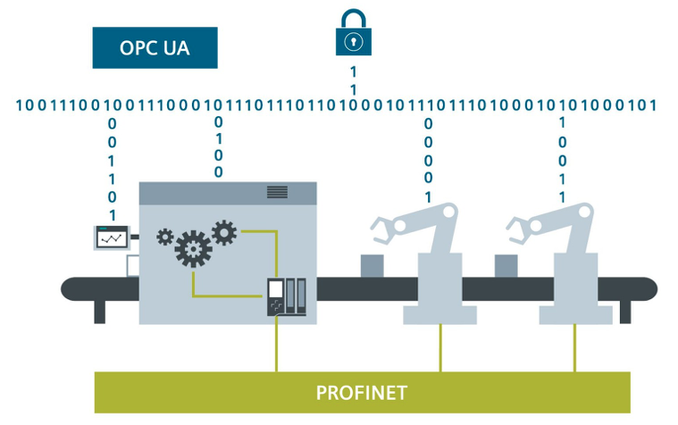
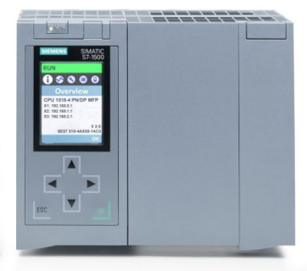
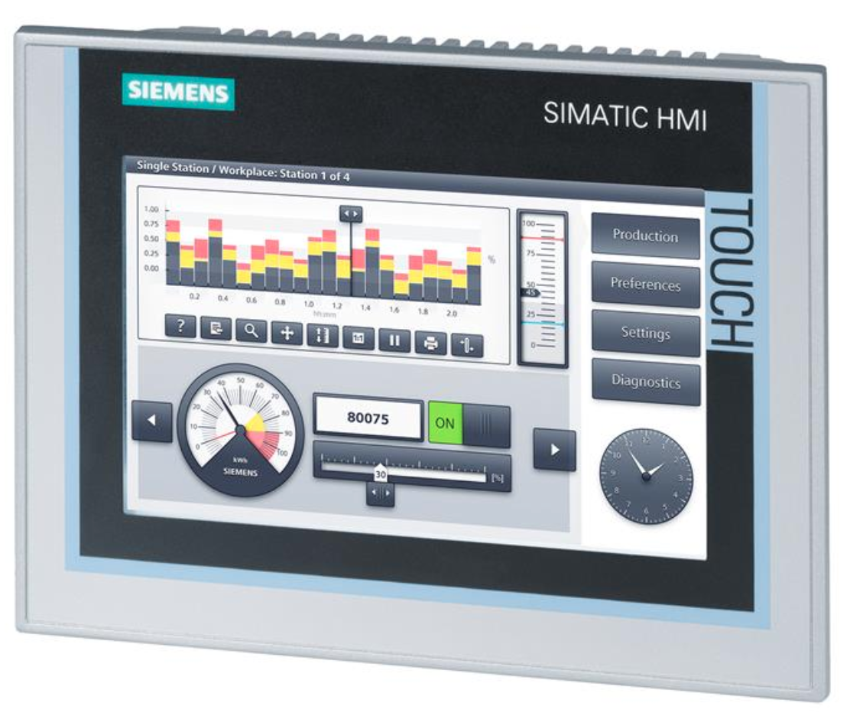


NEW
Gateway
Reactive, Asynchronous
Single Host or Clustered
In-Memory Data Grid
Database Logger
Query via GraphQL
Siemens
Comfort Panels
WinCC Unified
Source: https://new.siemens.com

